Slide 1
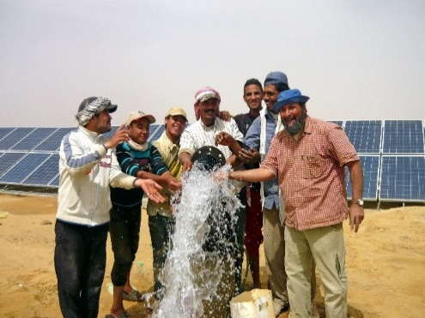

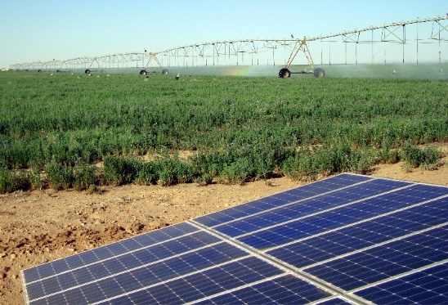

PS2-100 campaign materials
Pick, plug, pump

Slide 2
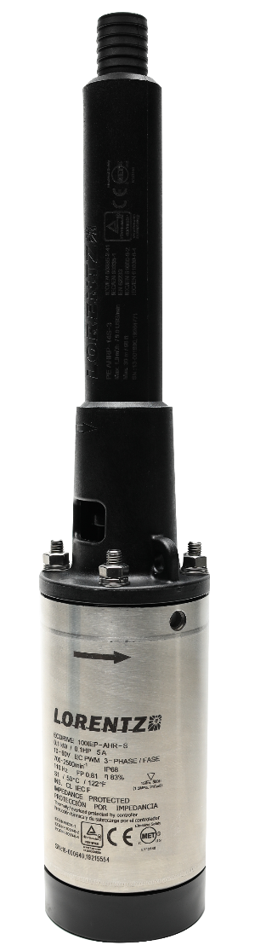
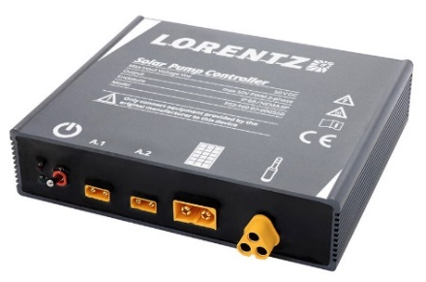
PS2-100 Materials
Document | Purpose | Where is it used
Partner brochure – 8 pages | Explain the product and use in partner language – focus on busines opportunity | To inform existing partners For distributors to recruit new PS2-100 partners
Customer brochure (general) – 4 pages | To educate customers on the benefits and flexibility of use | In retail, self served by the customer Can be emailed Web sites (generic)
Customer brochure (partner branded) – 4 pages | To educate customers on the benefits and flexibility of use but with 1 application at the center | Used where a specific application is defined (eg livestock) and allows the use of local faces / animals

Slide 3

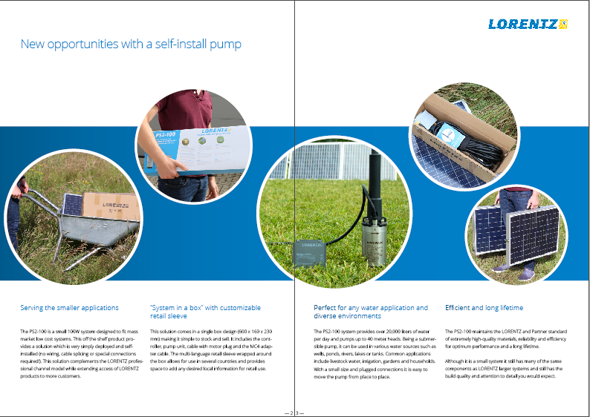
Partner brochure
Application independent brochure for partners and potential partners
Focus on product uniqueness and business opportunity
Show range of applications and provide technical data

Slide 4
Customer brochure
Remaining text is consistent for all applications, key features of flexibility, quality, reliability and for it to be used in different applications help the message.
Main image, sub images and text is changed to attract local markets - this could be change of cow type, focus on mini irrigation or look of people
Pdf generation will allow partners to change these and co-brand

Slide 5
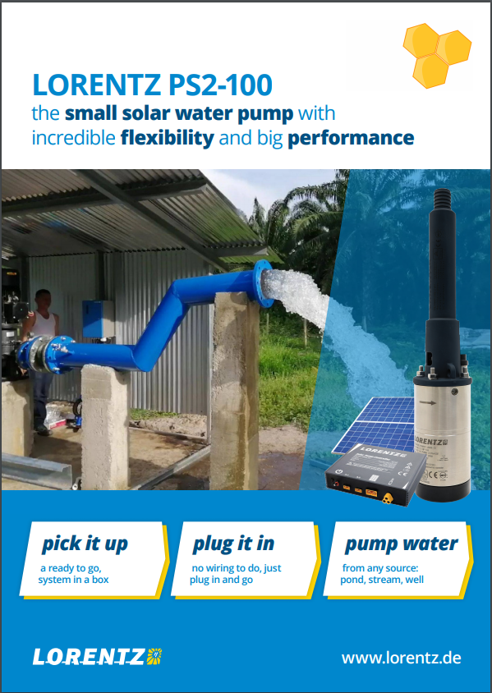

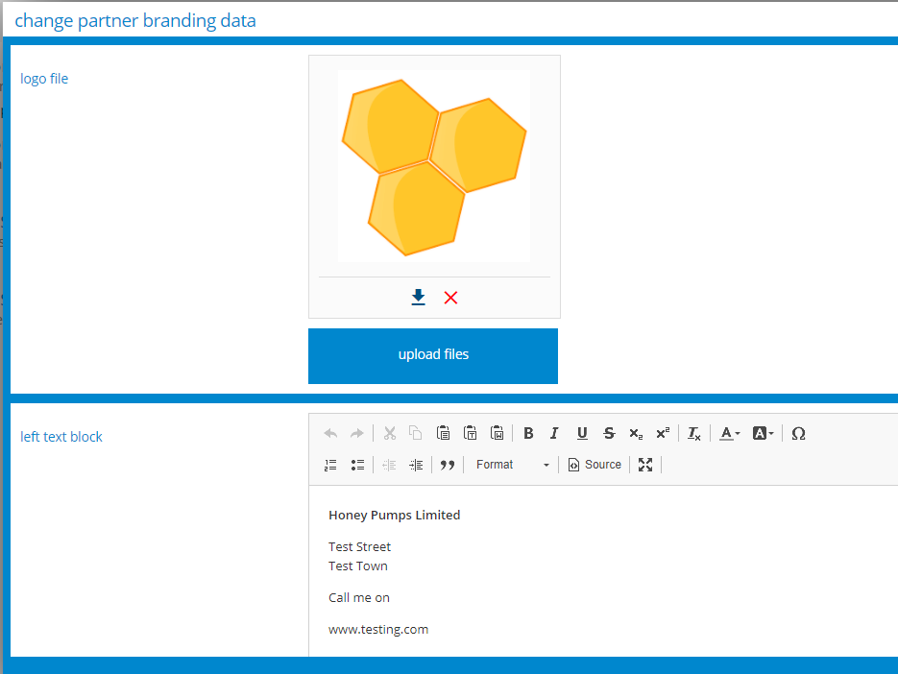
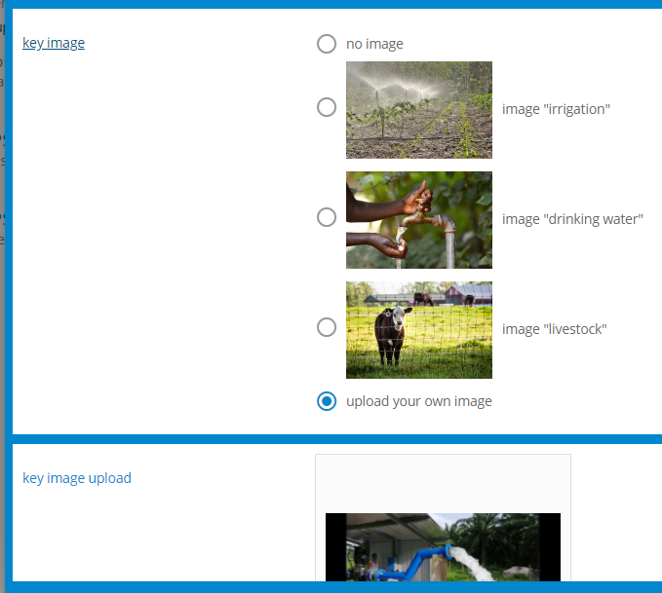
Customer brochure
Logo
Contact details on back page
Choose stock image to fit your application
Or upload custom image to match local market and local applications

Slide 6
Customer brochure

Slide 7
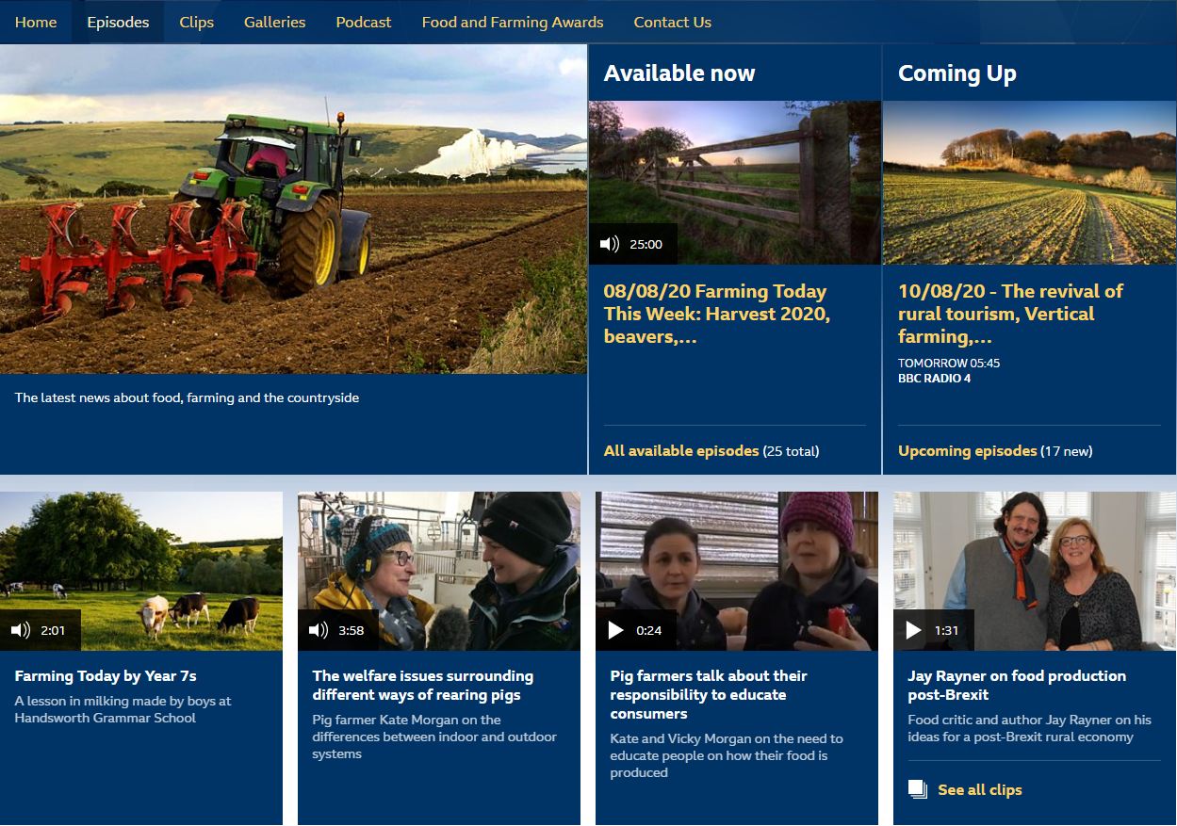
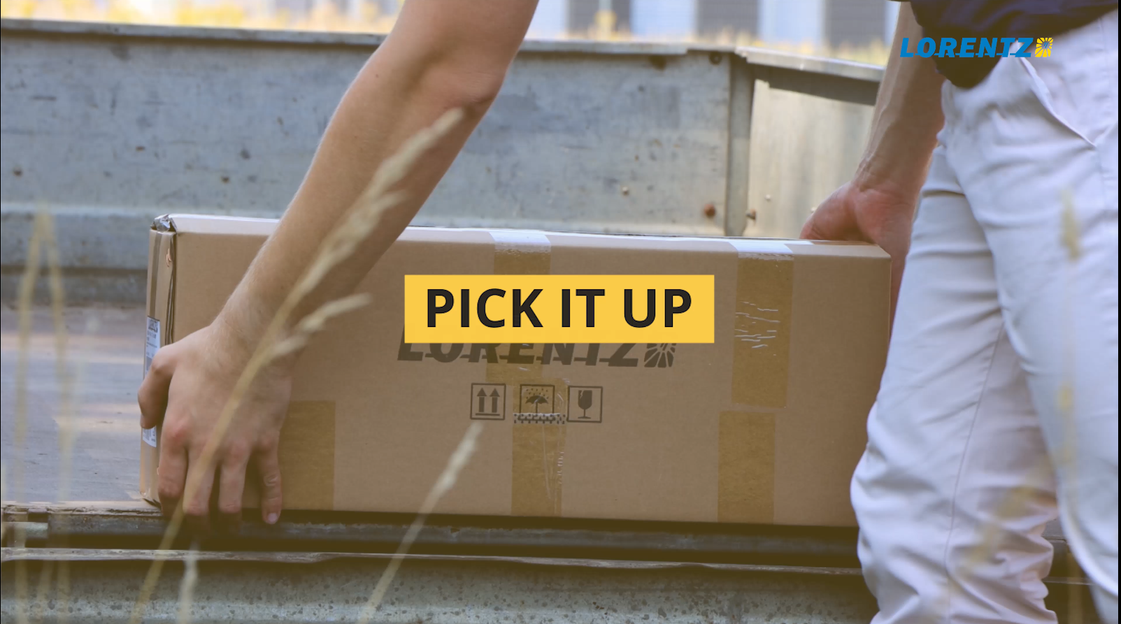
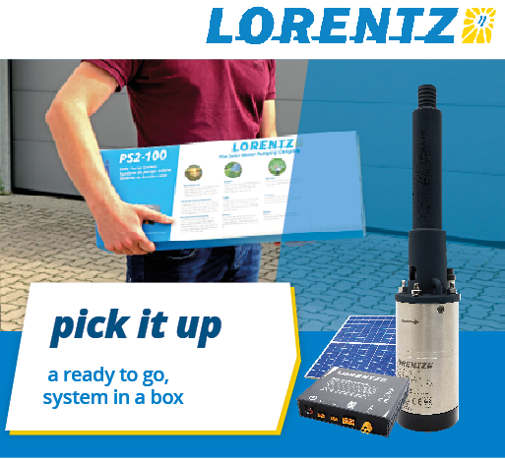
Other assets
Animated display ads (Adwords)
30 second into / teaser advert for social media and introducing the product

Slide 8
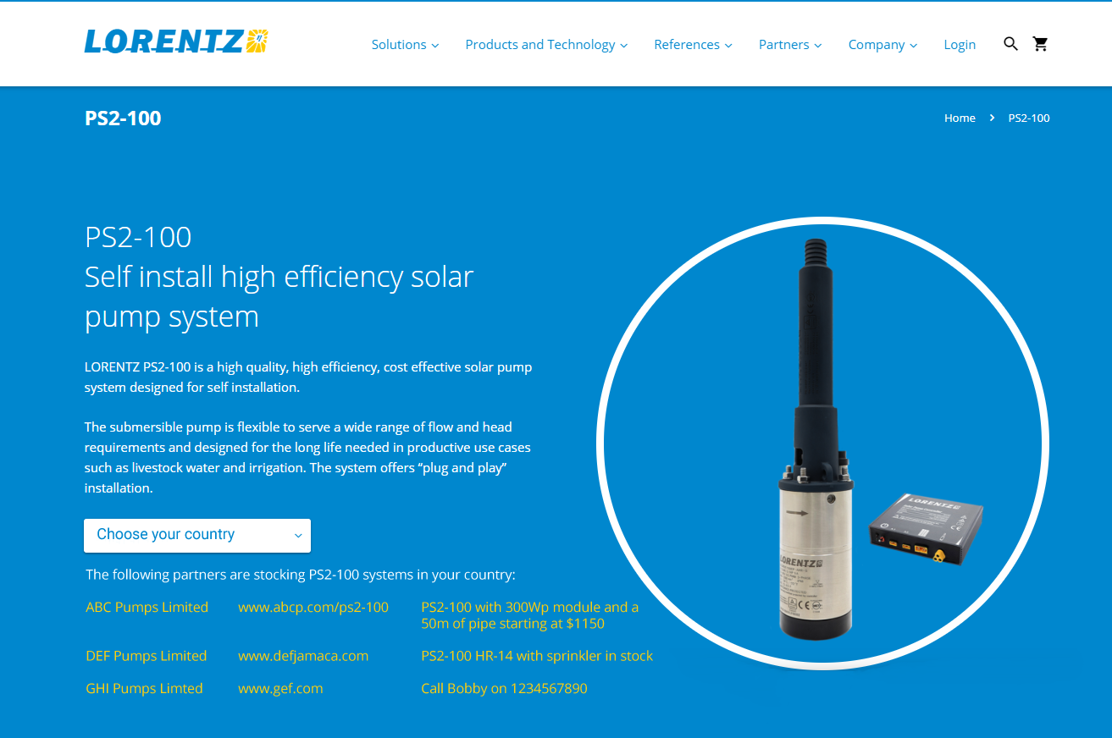
Web page with stockist listing
This is a special resource for retail customers visiting the LORENTZ website.
Will list “live stockists” by country
Simple for customers to find stockists
Allows for a custom message

Slide 9
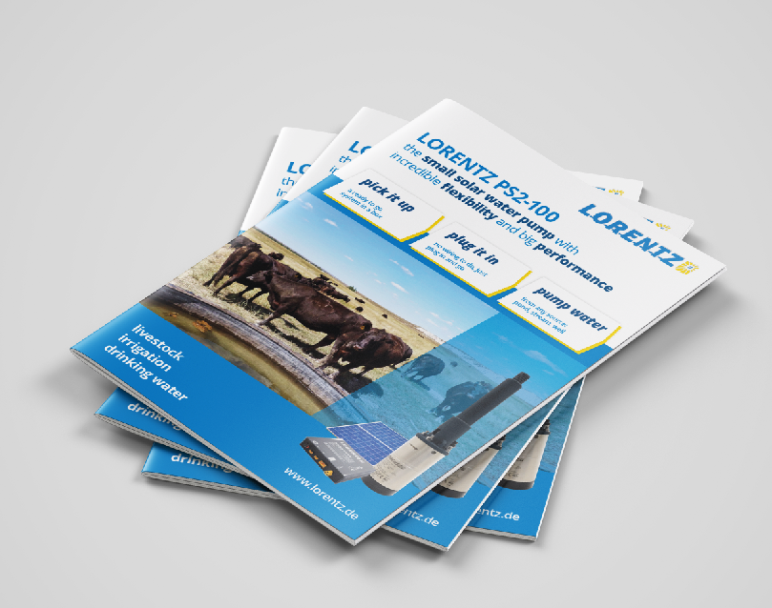
Pick, plug, pump campaign
Multi language, multi use materials for promoting PS2-100

